Slide 1







Campus
Expense Manager.
Group 2
08/12/2024
Group Members:
MAI ICH KIEN
BUI THAI DUONG
DOAN DO DAT
NGUYEN MINH ANH

Slide 2

Project Overview
A brief description of the CampusExpense Manager application. | CampusExpense Manager is a student expense management system that helps track, categorize, and analyze expenses. The project is designed to help users manage their finances more effectively.
Project objectives. | Provide tools to help students manage their personal finances easily and effectively. Track daily expenses, analyze spending trends and plan savings. Simplify sharing expenses within groups and make financial information transparent.
Target audience | College students, especially those living away from home, need to manage their personal expenses or share expenses with roommates. The system is designed to meet their needs in tracking expenses, analyzing finances, and planning effective savings.

Slide 3

Objectives of the App
Spending Tracking: Record and manage daily expenses, categorized by category.
Budgeting: Support monthly budget planning and track spending progress against budget.
Financial Analysis: Provide visual charts to understand spending trends and rates.
Ease of Use: Simple, user-friendly interface design, suitable for students.
Personalization: Allows you to create additional custom spending and income categories.

Slide 4


User Requirements
Expense Tracking:
Users need to record daily expenses with information such as amount, category, date, and notes.
Budget Alert:
Warning when spending exceeds the set budget.
Expense Classification:
Categorize expenses into clear categories for easy management.
Overview Report:
Display expense reports in the form of intuitive charts for users to easily track trends.
Friendly Interface:
Design a simple, easy-to-use interface, focusing on the student experience.
Expense Classification:
Categorize expenses into clear categories for easy management.

Slide 5
Systems Investigation and Research
Competitor Analysis:
Evaluate apps like Money Manager, Spendee, and Mint. Strengths include modern interfaces and expense reporting, while limitations are complexity and lack of student-specific customization.
Student Needs:
Students need simple, low-cost tools for daily expense management, budget alerts, and easy financial analysis, with features for group expense sharing and secure data storage.
Research Results:
Focus on a user-friendly interface, basic yet effective management, and add customization options and intuitive reports to meet student needs.

Slide 6
Project Scope and Constraints
Scope:
Develop a student expense management application, including expense tracking, budgeting, expense categorization, budget reporting and notifications.
Limitations:
The team's budget and technical experience are limited, requiring cost optimization and learning new technologies.
Constraints:
The design must be easy to use, compatible with mobile platforms and ensure user data security.

Slide 7




Tools and Technologies Used
Android Studio:
Java:
Figma:
SQLite:
The main IDE for developing Android apps, supporting features like coding, testing, and debugging.
A programming language for Android software, helping to build app features and logic.
User interface (UI/UX) design software, helping to create prototypes and wireframes for apps.
An internal database used to store spending information, budgets, and spending history.

Slide 8
Development Methodology
We chose Agile with iterative development. This method helps the team work in short cycles (sprints), developing and testing features continuously.
Why it works:
- Flexibility: Easily adjust requirements and features during development.
- Continuous improvement: Get regular feedback and improve the application after each cycle.
- Team friendly: Effectively manage progress and work for small teams.

Slide 9
Initial Design and Prototyping
The process started with creating wireframes for the app interface, defining key screens such as the home screen, spending entry, reporting, and budget settings. We then created an initial prototype to show the features and workflows.
User Feedback:
Users tested the prototype and provided feedback on the interface, ease of use, and smoothness. Based on the feedback, we tweaked the interface and improved the features, especially the ability to customize spending categories and budgets.

Slide 10
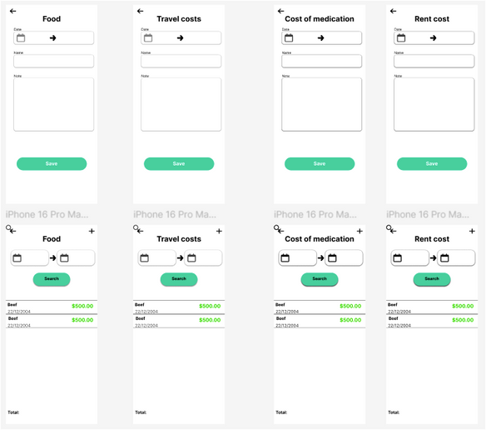
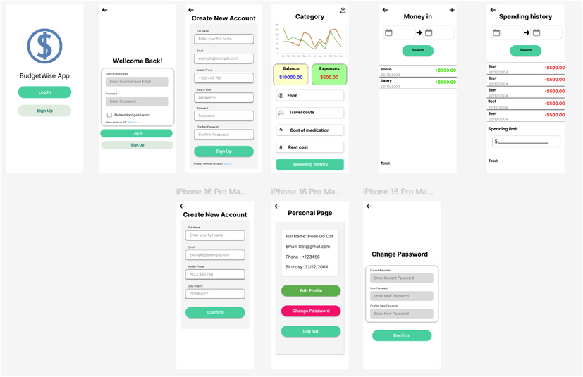
User Interface (UI) Design
Key Design Decisions:
- Simplicity and ease of use: The interface is minimalistic with clear, easy-to-use functions. - Focus on user experience: Colors and icons are used to create visuals and recognition. - Accessibility: Key features such as spending tracking, budgeting, and reporting are placed in easy-to-access locations. Design rationale: The interface is designed to suit the needs of students, making it easy for them to track their spending without getting confused. The simplicity helps users quickly get familiar with and use the application effectively.
Design rationale:
The interface is designed to suit the needs of students, making it easy for them to track their spending without getting confused. The simplicity helps users quickly get familiar with and use the application effectively.

Slide 11
Backend Architecture
Backend Selection:
Firebase was chosen as the primary backend platform, providing services such as user data storage, user authentication, and data synchronization across devices. Firebase supports services such as Firebase Authentication, Firestore, and Realtime Database for data storage and management.
Scalability Support:
Firebase provides flexible scalability, allowing the app to handle increasing user traffic without changing the backend structure. Services such as Realtime Database and Firestore can scale automatically as needed, helping the app maintain stable performance as it grows.

Slide 12
Core Features Implemented
Expense Record:
Users can easily enter daily expenses into the application. This feature meets the needs of students to manage their expenses, helping to track expenses in real time.
Select the spending category:
- Food: Includes expenses for meals, drinks, and other food services.
- Transportation: Includes travel expenses such as bus tickets, gas, or public transportation.
- Medicine: Expenses for medicines, medical examinations, and other medical services.
This feature helps students track their expenses more easily.
View spending summary:
Provides an overview report of daily, weekly, and monthly expenses, allowing users to clearly understand their financial situation. This feature helps students easily control their budget and avoid overspending.

Slide 13
Additional Features
Spending History:
Allows users to review all recorded spending by day, week, month, making it easy to track spending trends and adjust budgets.
Overspending Notifications:
Provides automatic notifications when users spend more than their set budget. This feature helps users control spending and avoid exceeding limits.
Prioritization based on user feedback:
These features are implemented based on users' actual needs, helping to improve their ability to track and manage spending, while helping them gain a better understanding of their financial situation.

Slide 14
Data Management and Security
Data Management:
User data, including spending and budget information, is securely stored in Firebase Firestore or Realtime Database, ensuring fast retrieval and cross-device synchronization.
Security:
- User Authentication: Firebase Authentication is used to authenticate users via methods such as email/password or Google account, ensuring only valid users can access the app.
- Data Security: Firebase provides robust security mechanisms, including role-based access and custom data security rules, to help protect user data from unauthorized access.

Slide 15
User Testing and Feedback
User Testing:
We conducted user testing with a group of students, asking them to test the app's key features such as recording expenses, creating categories, and viewing expense reports.
Feedback received:
Users found the interface friendly and easy to use, but some feedback was that the button placement and operations were too complicated.
Usability changes:
- Adjusted button placement: Important buttons such as "Add expense" and "View report" were moved to more accessible locations.
- Simplified process: The expense entry process has been optimized, reducing the number of steps required, making the user experience faster and smoother.

Slide 16
Challenges Faced
Technical challenges:
Sync data between devices: Encountered latency and inaccurate synchronization issues. We Optimized the use of Firebase Realtime Database and improved the synchronization process.
Time constraints:
Short time and large workload. We Prioritized core features and applied Agile methodology, dividing work into short sprints to ensure progress.

Slide 17
Quality Assurance and Testing
Functionality Testing: We tested the main features of the application such as expense recording, category categorization, and expense report viewing. Each feature was thoroughly tested to ensure that it worked correctly and met user requirements.
Usability Testing: Users tested the interface to ensure user-friendliness and ease of use. Elements such as button placement, data entry process, and report viewing were tested and optimized based on user feedback.
Results: The application achieved high reliability, stable features, and good performance. The interface was rated by users as easy to use and intuitive.

Slide 18
Risk Management
Risks identified:
- Limited mobile experience: The team's lack of experience in mobile app development could affect the progress and quality of the product.
- Scope expansion: Adding new features could exceed the project's capabilities and time.
Risk mitigation strategies:
- Training and support: The team took courses and consulted documents to improve their mobile development skills.
- Core feature prioritization: We limited the project scope, focusing on the most important features and gradually completed the secondary features later.

Slide 19
Project Management and Collaboration
Collaboration tools:
GitHub: Used to manage source code, track progress, and coordinate between team members through pull requests and issues.
Collaboration strategies:
- Regular team meetings: Hold weekly online meetings to discuss progress, resolve issues, and update work.
- Clear job assignment: Each member has a specific role, helping to optimize the workflow and increase collaboration efficiency.

Slide 20
Performance Evaluation Criteria
User Satisfaction and Functionality: Assess how well the app meets user needs, including the ability to accurately record, categorize, and report expenses.
User Satisfaction: Survey and provide user feedback on ease of use, user-friendly interface, and useful features.
Overall App Quality: Assess the app’s stability, performance, and functionality, including factors such as load time, smoothness of the interface, and absence of critical errors during use.

Slide 21
Summary of User Requirements Fulfillment
The application has fully met the initial user requirements:
Expense recording: The feature allows users to record daily expenses and classify them into groups such as Food, Transportation, Medicine.
Budget warning: The feature notifies when spending exceeds the budget set for each spending group.
Friendly interface: The interface is simple and easy to use, with clear buttons and an easy-to-understand data entry process.
Overview report: The features report expenses by day/month and display data in the form of charts, helping users to track spending intuitively.

Slide 22
Lessons Learned
The project helped us develop our mobile development skills, from using Android Studio and Firebase to optimizing performance and designing simple user interfaces. We also realized the importance of collecting user feedback and improving the app based on real needs, making the app easier to use and more responsive to user needs.

Slide 23
Feedback Analysis and Future Improvements
Feedback received:
Users responded positively to the simple and easy-to-use interface. However, some suggested improvements to the spending reporting feature, especially the ability to export reports to Excel.
Actions taken:
Based on feedback, the team improved the budget notification feature and optimized the display of the report graph.
Future improvements:
- Enhanced reporting features: Add the ability to export spending reports to Excel or PDF.
- Integrated data synchronization: Provide data synchronization across devices to support users to easily access from multiple platforms.
- Group sharing feature: Improve the ability to share spending among family members or groups of friends.

Slide 24
Q&A Preparation

Slide 25
Conclusion
The CampusExpense Manager project has succeeded in building a simple and effective expense management application for students, with features such as expense recording, budget alerts, and expense reports. The team overcame technical challenges and completed the project on schedule thanks to close collaboration and continuous efforts. We would like to thank the valuable support and feedback, which helped us improve the product and learn throughout the project development process.

Slide 26
Thank you very much!

